Slide 1
AP Ch 12
Cell Cycle

Slide 2
Cell division
Why?
cells divide to make identical copies
functions in reproduction, growth and repair
makes a copy of a cell’s DNA or genome

Slide 3
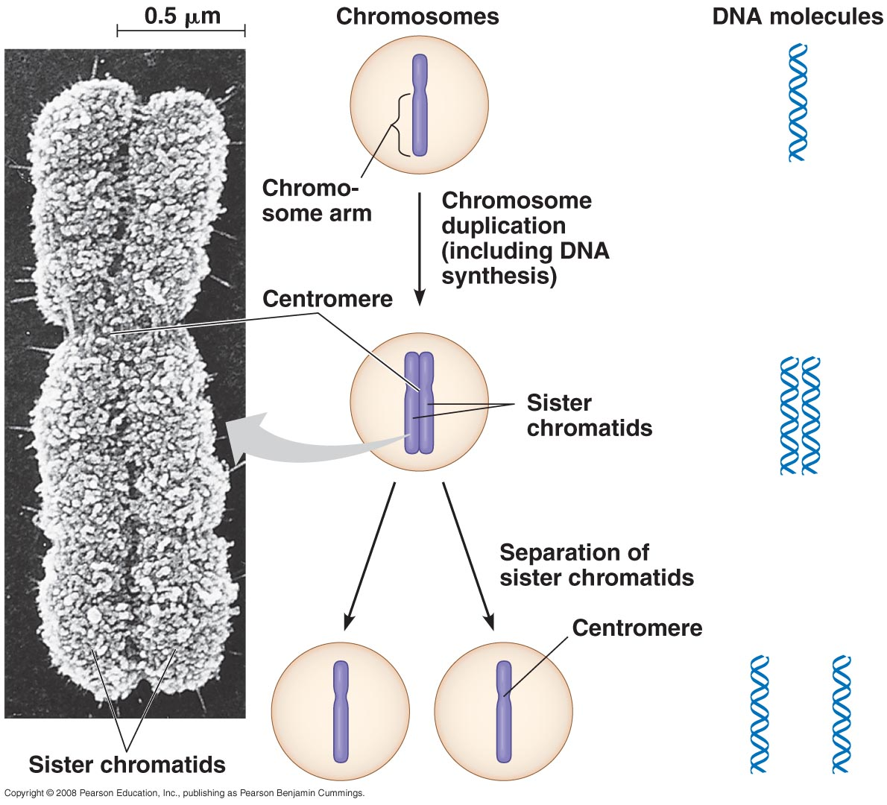
Genome= all the genes and chromosomes of an organism
Gene – piece of DNA that codes for a protein
Chromosome = packaged DNA
Chromatin= supercoiled DNA/protein complex
Sister chromatid = identical chromosome connected at the centromere (center)

Slide 4
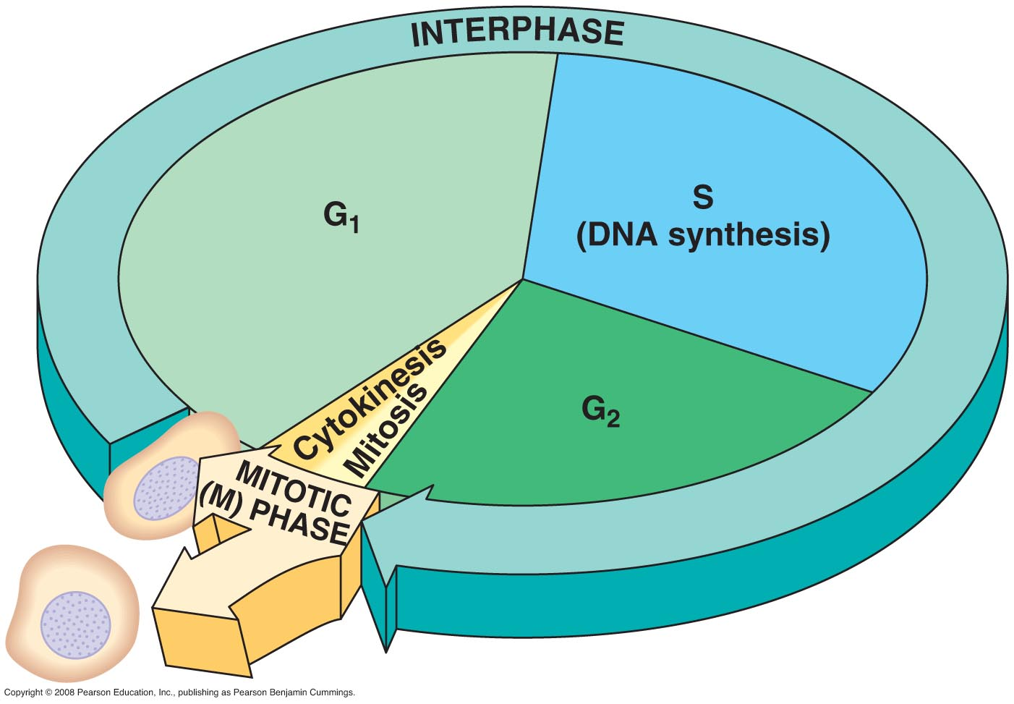
Cell Cycle
cycle of growth and division of a cell, makes 2 identical cells, these are somatic (non sex cells), p231

Slide 5
1) Interphase
nondividing stage, 90% of cell cycle
most of cell’s growth occurs here
4 parts
1) G₁ phase – gap 1, organelles duplicate*
2) G₀ phase – dormant nondividing state
3) S phase – synthesis, DNA is copied*
4) G₂ phase – completion of growth
* important checkpoints

Slide 6
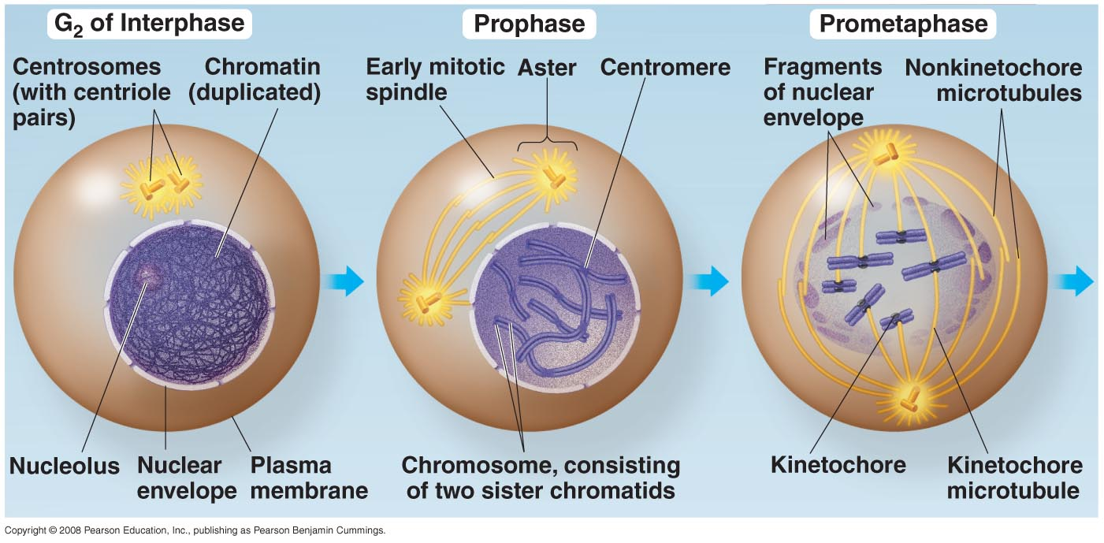
2) Mitosis
division of cell’s nucleus, PPMAT, p.232-233
Prophase - chromatin condenses into chromosomes, spindle fiber forms, centrosomes and aster move apart toward the poles, nucleoli disappear
ProMetaphase - nuclear envelope disappears, microtubules attach to the chromosomes at the kinetochore (middle)

Slide 7
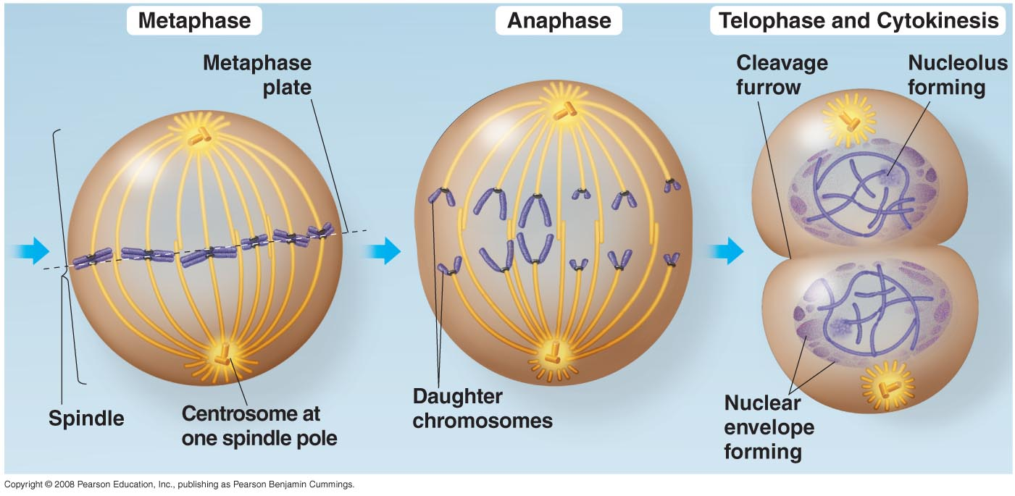
Metaphase - centrosomes are at opposite poles, chromosomes line up at the center or metaphase plate
Anaphase - paired daughter (identical) c’somes separate and begin to move toward the opposite poles (1 copy to each end)
Telophase = nuclear envelope begins to reform, nucleoli reappear, c’somes uncoil = less condensed, cleavage furrow forms

Slide 8
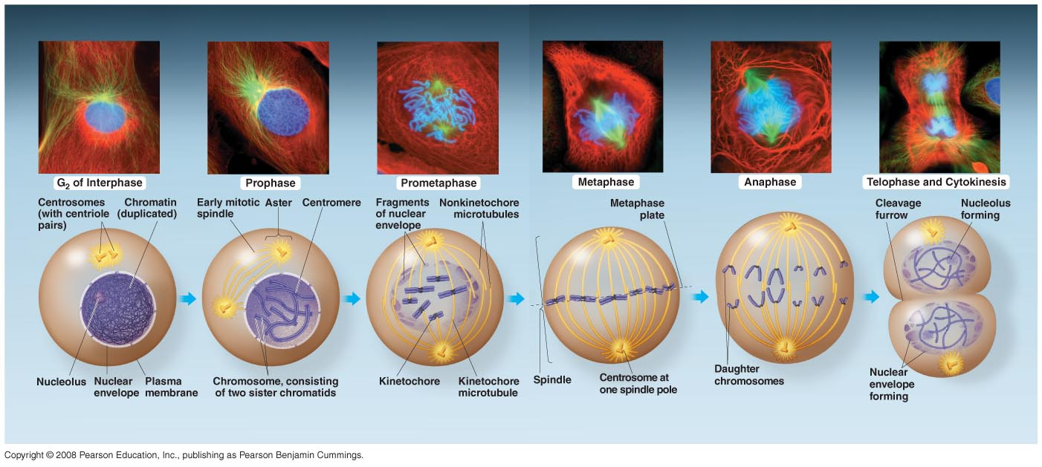
Please see pages 232-233

Slide 9
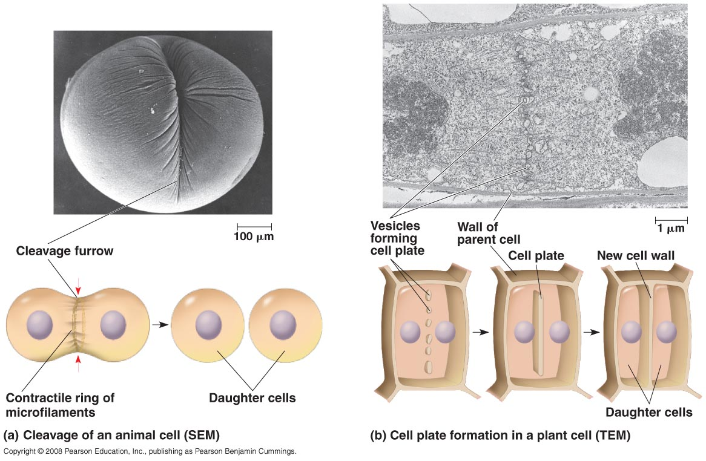
3) Cytokinesis
= division of the cytoplasm
in a plant, a cell plate is made instead, p.235
movie

Slide 11
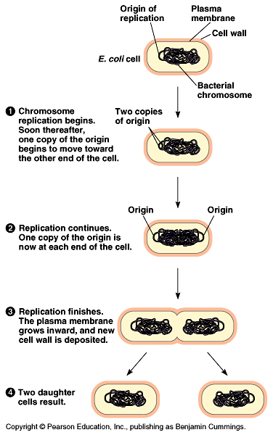
Prokaryotes → reproduce via binary fission – double and divide, why so simple?

Slide 12
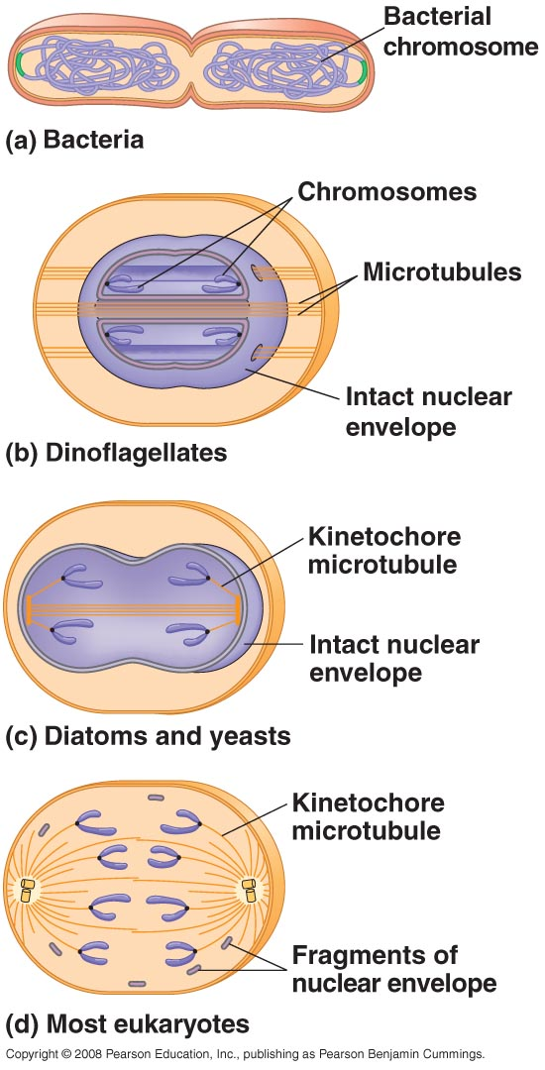
Eukaryotes → reproduce via cell division, theory that binary fission evolved into cell division, look at p237

Slide 13
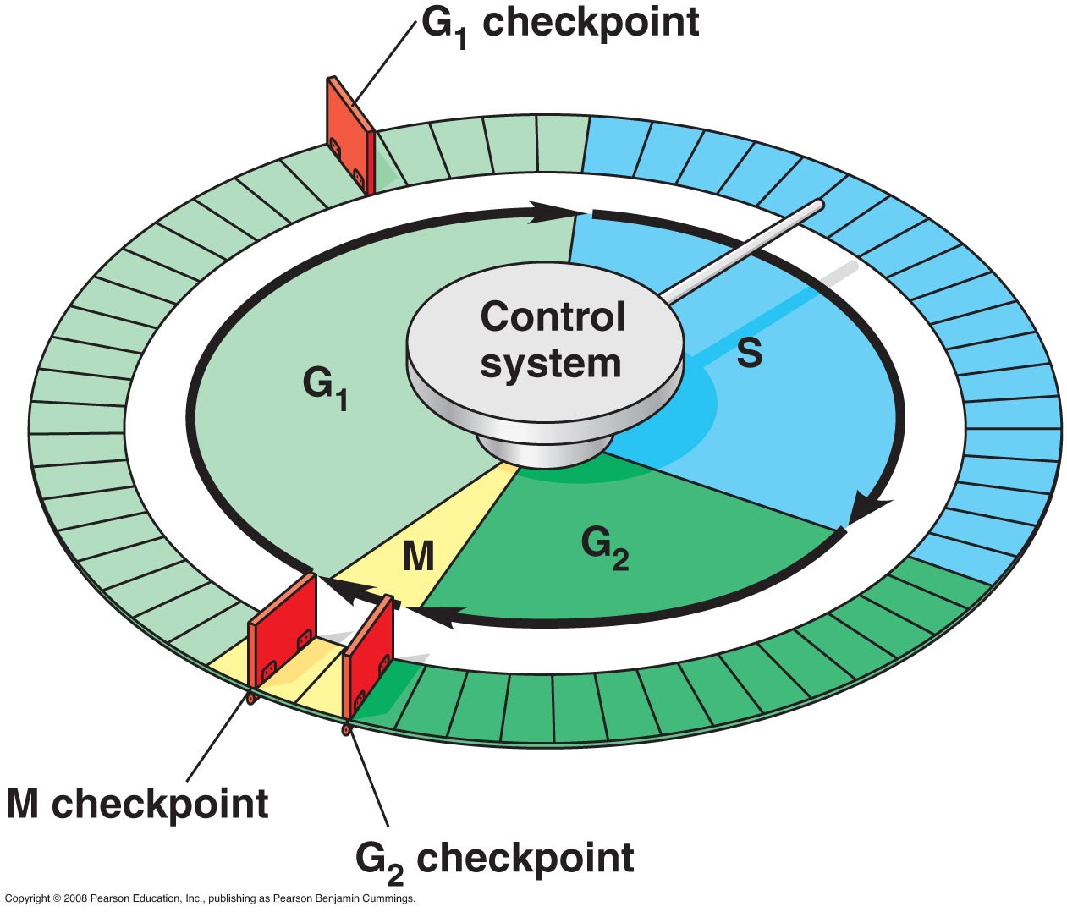
Regulation of the Cell Cycle
different cells divide at different rates, depends on the cell type, ex. skin vs. nerve
there are 3 checkpoints in the cell cycle, these are built in stop signals, check the status of the cell
Which is most important?

Slide 14
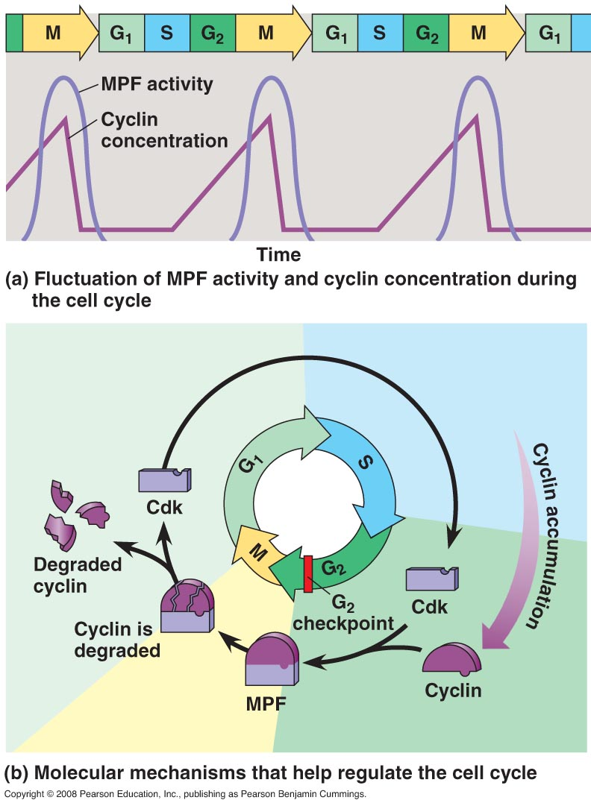
protein kinases – enzymes that add a phosphate from ATP to a protein→ causes phosphorylation → causes a change in shape of a protein
→ kinases must be attached to a cyclin protein
called cyclin dependent kinases (Cdks)
concentration of cyclin contols the cycle

Slide 15
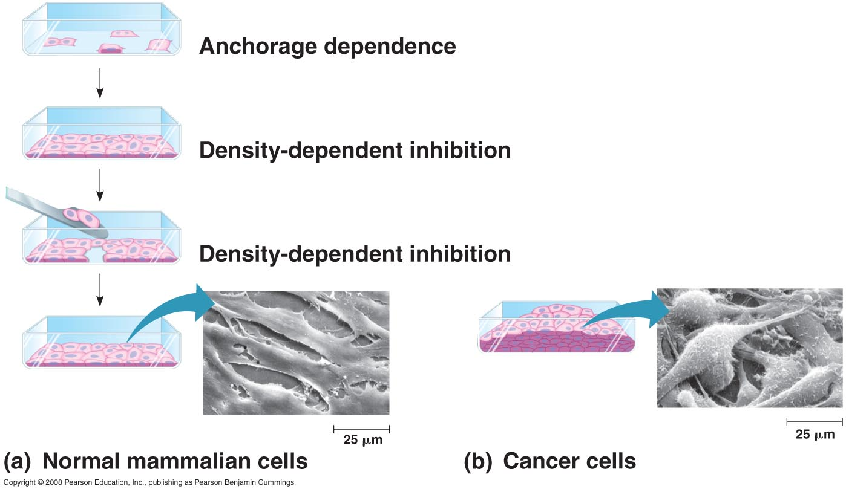
Types of signals
a) Intracellular control signals
b) External signals
chemical- ex. quantity of growth factors stimulate cells to divide
physical – contact, ex. Density dependent, stop growing on contact (also anchorage dependent)

Slide 16
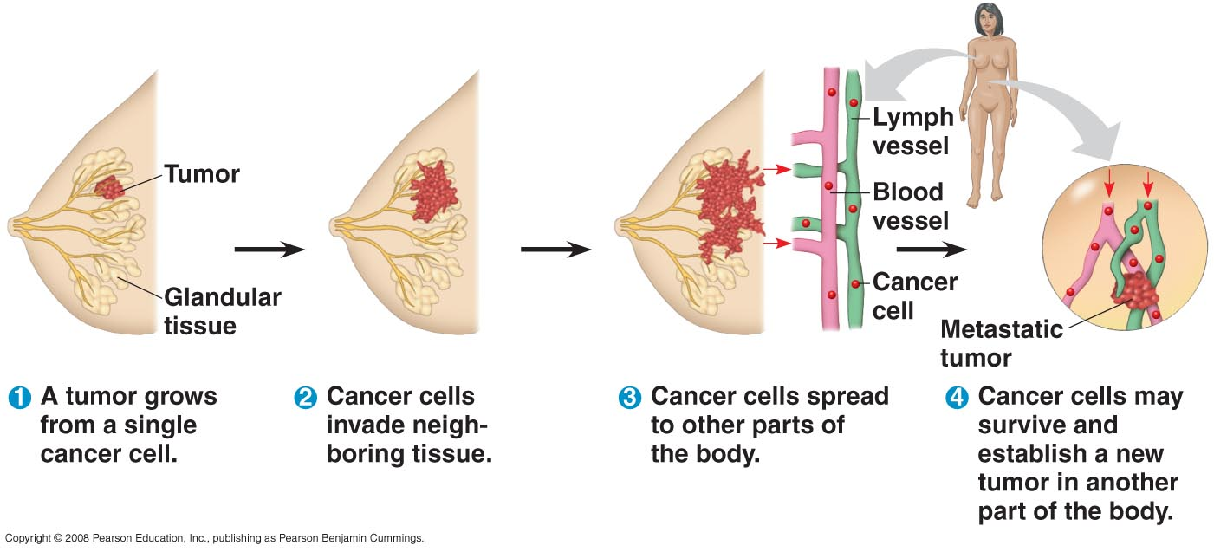
Cancer
= uncontrolled cell growth, chemical and physical controls do not work, nonfunctional, cancer cam
Tumor – mass of abnormal cells

Slide 17
Benign – does not spread
Malignant – spreads, impairs function of organ(s)
Metastasis – spreads to other parts of the body

Slide 18
Self Quiz

Slide 19
Ch 13
Meiosis

Slide 20
Heredity - pass biological traits to the next generation
Variation- inherited differences between species
Genetics - study of heredity and variation
Asexual reproduction – no sex, binary fission, little variation
Sexual reproduction - adds variation, 2 parents, 1/2 genes from each, movie
somatic cell= autosome= non-sex cell humans have 22 pairs, diploid (2n), humans 2n=46
gamete - sex cell, haploid (n), 1 pair, humans n=?

Slide 21
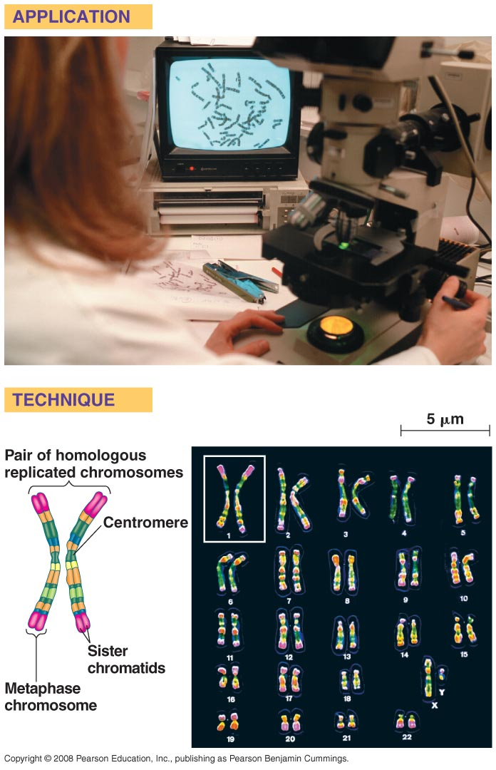
Homologous chromosomes - pair of chromosomes of same size with same loci (location of gene) (except X, Y)
1 of each homologous chromosome is inherited from each parent
Karyotype- display of all one's chromosomes, p.250
- chromosomes are lined up from biggest to shortest

Slide 22
Fertilization
= union of 2 gametes to form a zygote (2n)
gametes = cells made by meiosis, made in ovaries/testes
not all organisms use meiosis, ex. Bacteria, fungi use mitosis with haploid organisms and meiosis with diploid organisms
- plants have alt. of generation

Slide 23
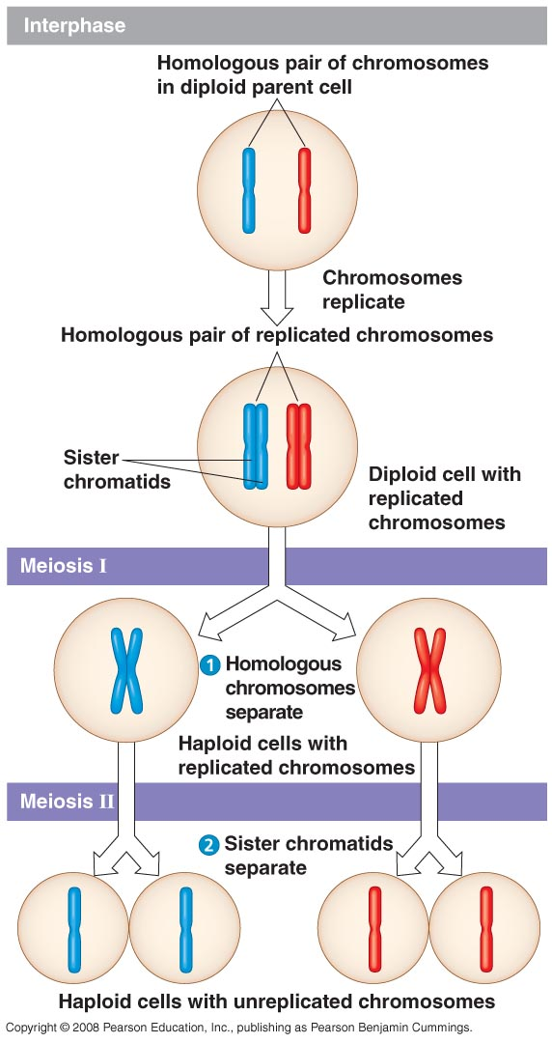
Meiosis
2-stage type of cell division that results in haploid sex cells, reduces chromosome number in half
similar to mitosis, but 2 stages, ½ the chromosomes, 4 cells made (not 2), cells not identical, *p.254-255
- so… which came 1st and which is of more value?

Slide 24
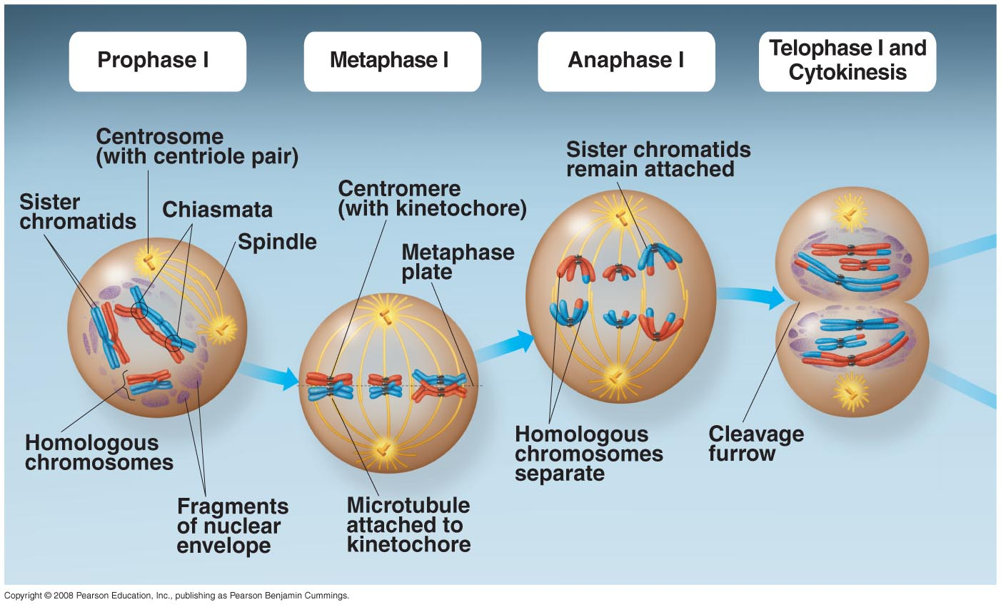

Slide 25
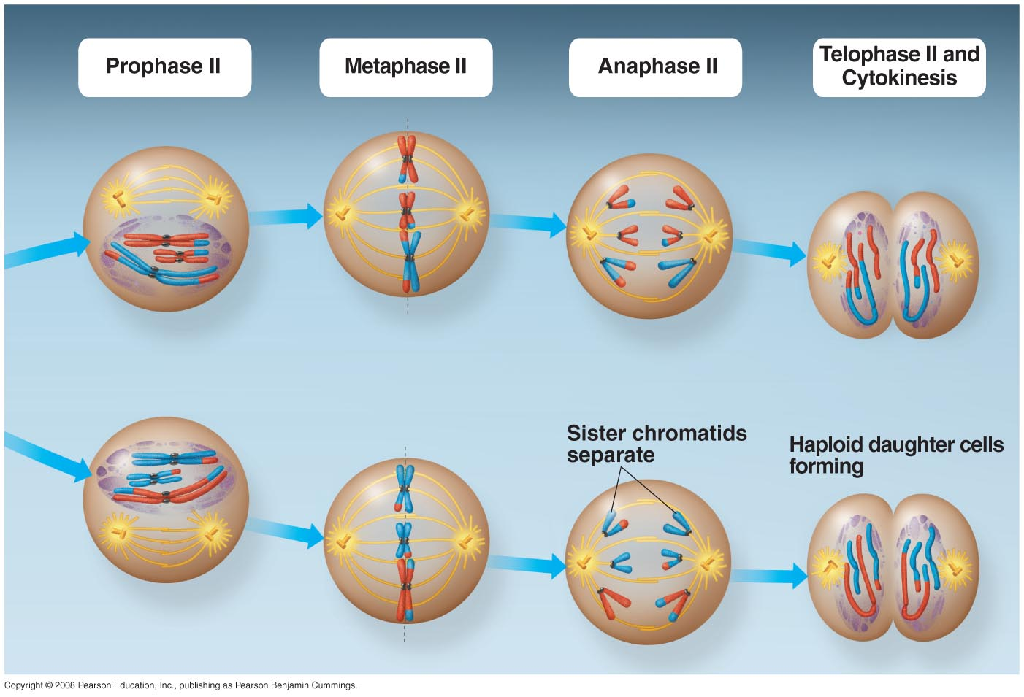

Slide 27
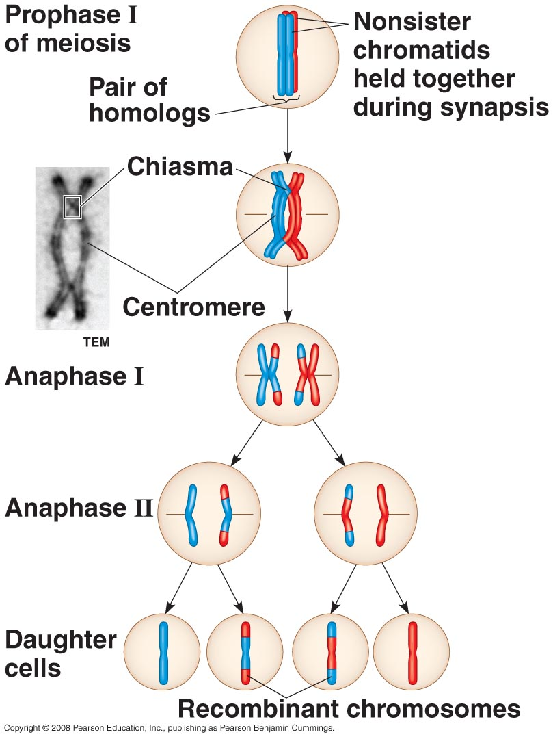
Steps
Interphase 1- chromosomes replicate
Meiosis 1 – like mitosis, chromosomes separate
Prophase 1- synapse occurs = homologous c’somes come together
tetrad forms - complex of 4 chromosomes
crossing over = exchange of information between homologous c’somes (nonsister chromatids) (linked by chiasmata), p.257

Slide 28
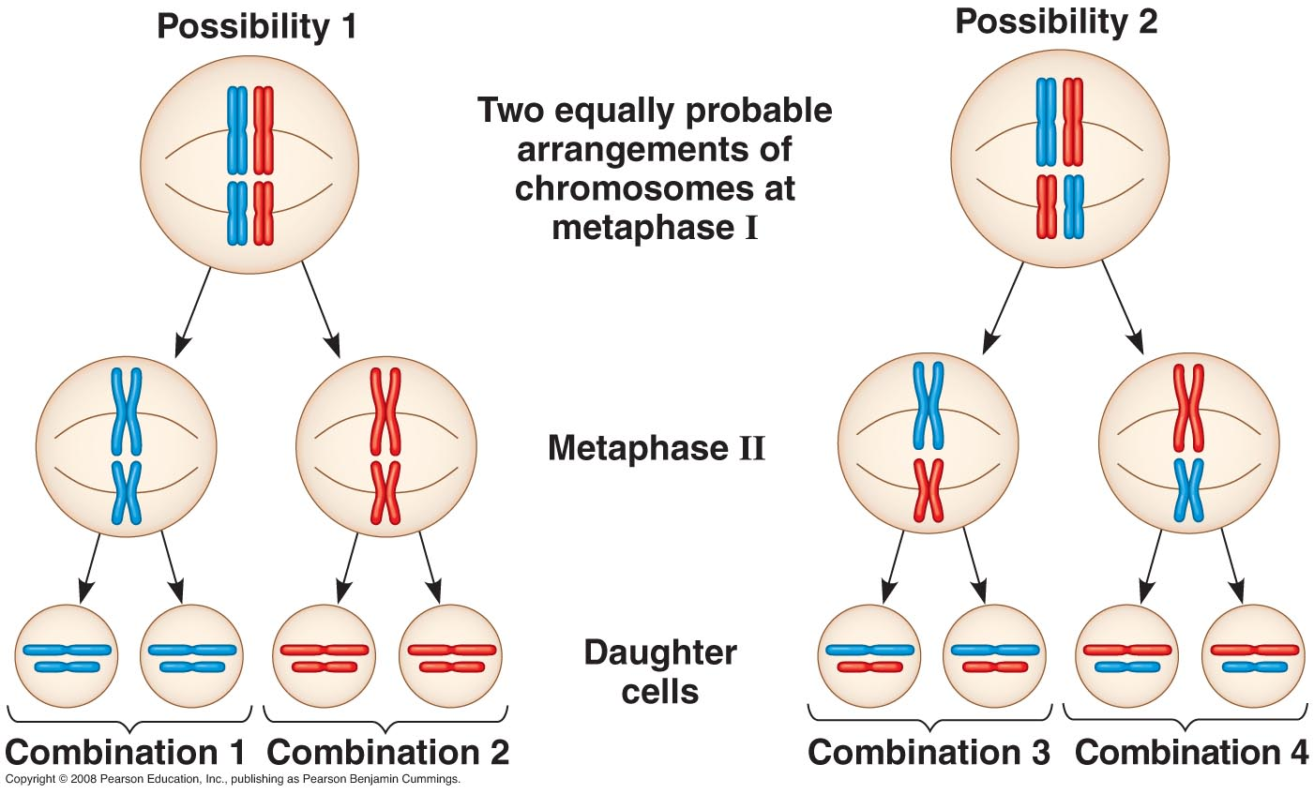
Metaphase 1 - tetrads line up at equator, differing possibilities
Anaphase 1- homologues separate and move toward opposite poles, sister chromatids remain attached
Telophase 1- spindle gone, ne reforms, cell pinches in
Cytokinesis - cell divides, each cell is haploid (with 2 sister c’tids)
Interkinesis - stage in between, no interphase, so no doubling

Slide 29
Meiosis 2- (just like mitosis)
but, get 4 cells that are haploid (n) and are not identical
movie

Slide 30
Mitosis v. Meiosis, *p257
1) Meiosis reduces the chromosome number
both contain 1 duplication, but 2 divisions in meiosis
2) Meiosis created variation via crossing over, mitosis = identical
3) Meiosis separates pairs of chromosomes, mitosis separates individual chromosomes

Slide 31
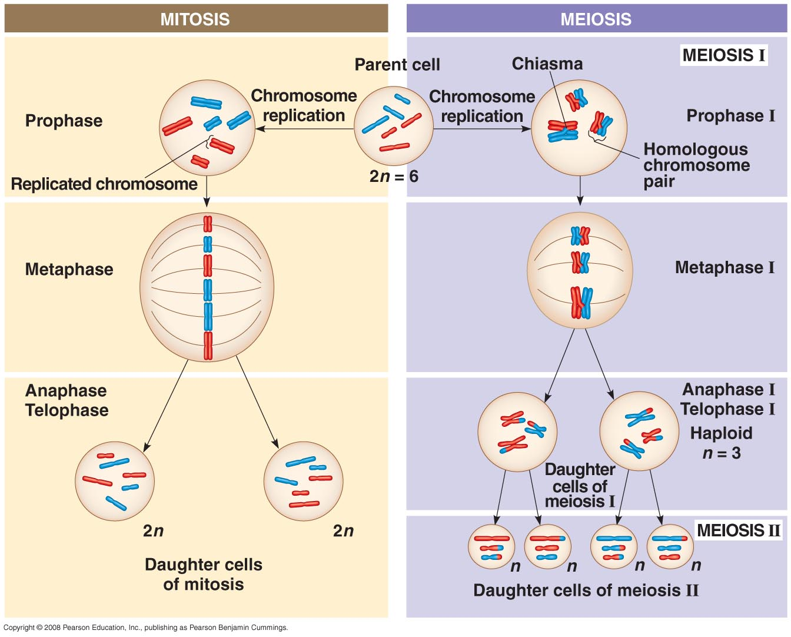

Slide 33
Genetic Variation
1) Independent assortment = chromosomes assort independently of one another
metaphase 1= 50-50 chance you will get a chromosome from mom or dad, 2²³ combos of chromosomes
2) Crossing over- at prophase 1 (p.259), a mix of mom and dads chromosomes can occur and exchange, 2-3 per chromosome
3) Random fertilization- 2²³ dif. sperm, 2²³ dif. eggs combine, + mutations occur
- fittest survive?

